Slide 1
Calculator using GUI
PRESENTOR: Nilesh patil

Slide 2
Project Overview
A calculator is basically a program on a computer that simulates the behavior of any hand held calculator useful for performing
Mathematical Calculations. It is a very basic device used in our everyday lives. Now all the smartphones also have a Calculator application in them.
While creating any GUI Application there are mainly two steps:
The first step is to create a User Interface.
The second step is the most important one and in this, to add functionalities to the GUI

Slide 3
Methodology
Tools - Python
Python Libraries - tkinter.
Tkinter :- Tkinter is the standard GUI library for Python. Python when combined with Tkinter provides a fast and easy way to create GUI applications. Tkinter provides a powerful object-oriented interface to the Tk GUI toolkit.

Slide 4
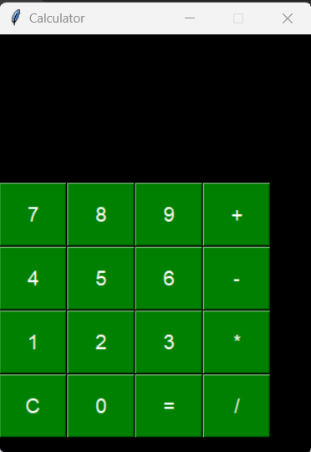
GUI interface

Slide 5
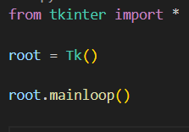
How it works
Tk() - To create a main window, tkinter offers a method Tk()
mainloop() - is an infinite loop used to run the application, wait for an event to occur and process the event as long as the window is not closed.

Slide 6
Widget- Button

Slide 7
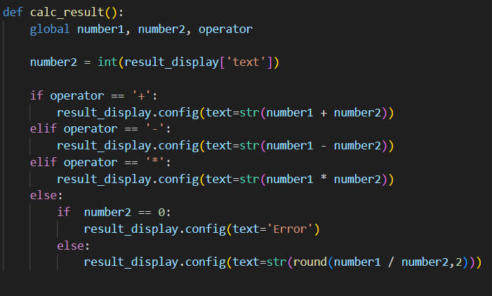
Operations

Slide 8
Links
GIT Hub :

Slide 9
Thank you

